Slide 1
CS246: Web Information Systems -- Introduction
Professor Junghoo “John” Cho

Slide 2
Today’s Topics
Introduction
Course overview
Course logistics
Paper reading assignments
Class project

Slide 3
Instructor
Instructor: Junghoo “John” Cho
Email: cho@cs.ucla.edu
Office hour: Tue 2:30 – 3:30PM
Zoom: https://ucla.zoom.us/j/93519403269, No password
Research area: search engine, text analysis and mining
TA
Manoj Reddy
Email: mdareddy@cs.ucla.edu
Office hour: TBD

Slide 4
Tell us about YOU
Name
Department & Program
Where you are from (or anything that you want to share)

Slide 5
Next Topic: Course Overview

Slide 6
Overview: Information Galore
Biblio sever
Legacy database
Plain text files

Slide 7
Central Problem
How to discover and access information on the Internet?
Three major approaches
Central indexing
E.g., Web search engine
Dynamic integration
E.g., comparison shopping services
Data mining
E.g., knowledge graph

Slide 8
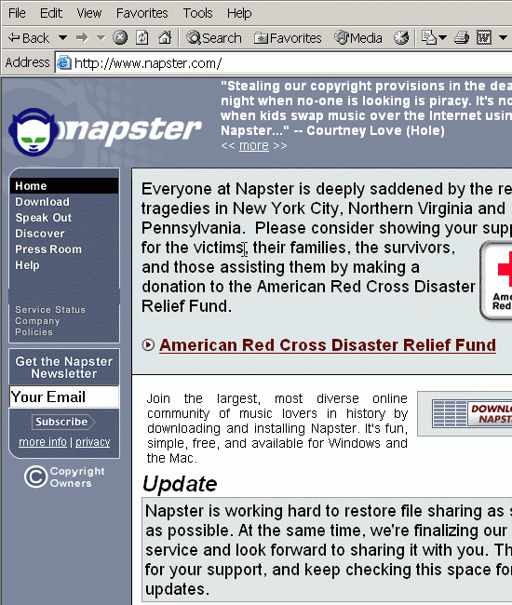
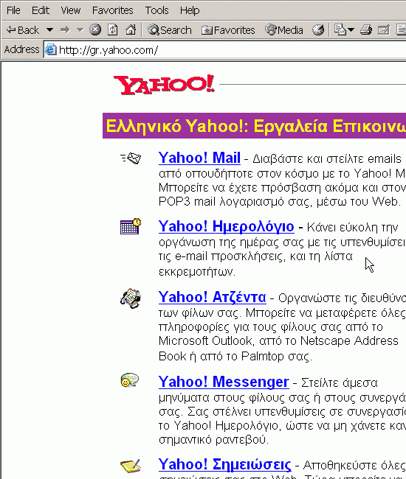
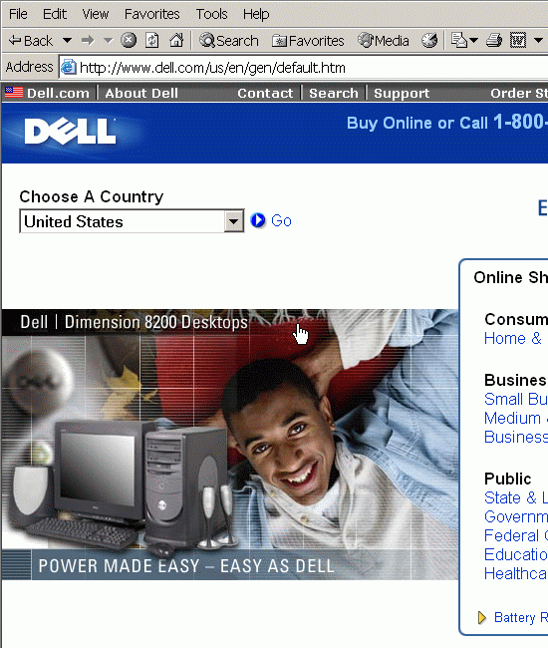
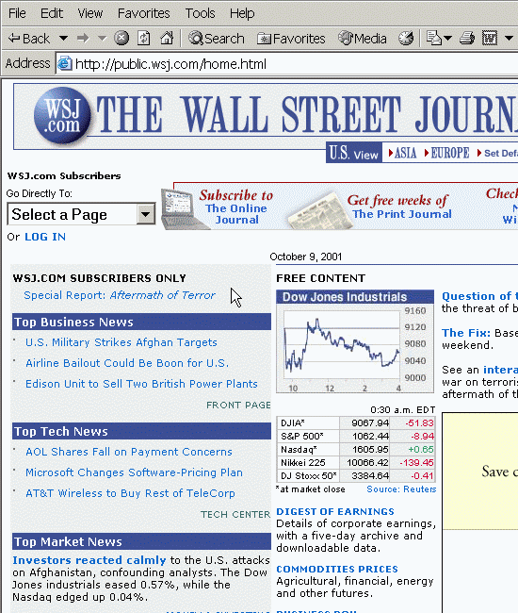
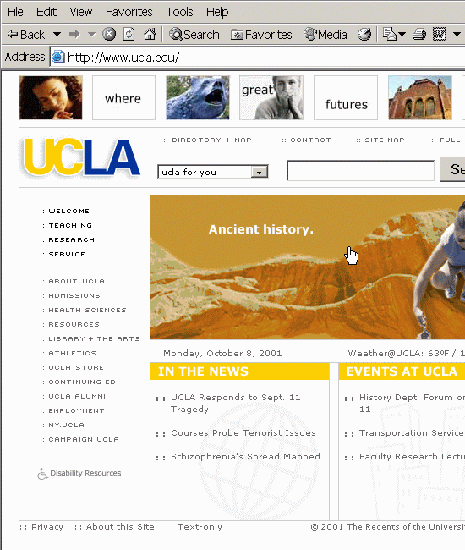
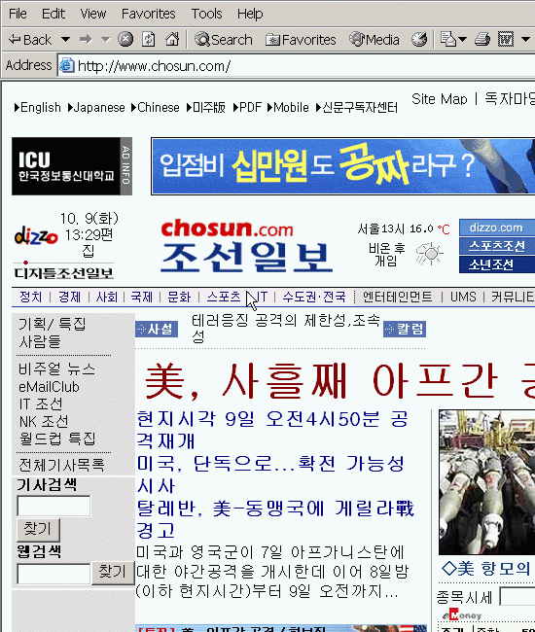
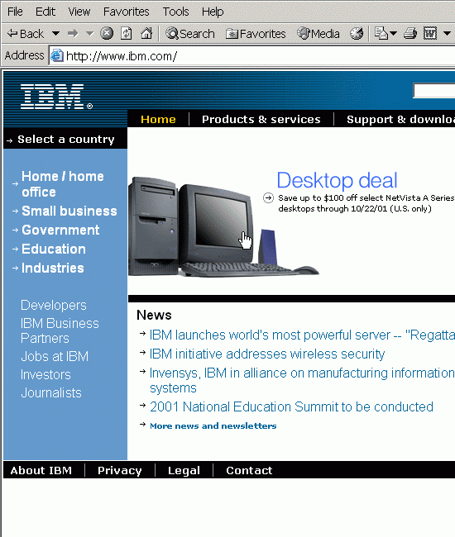
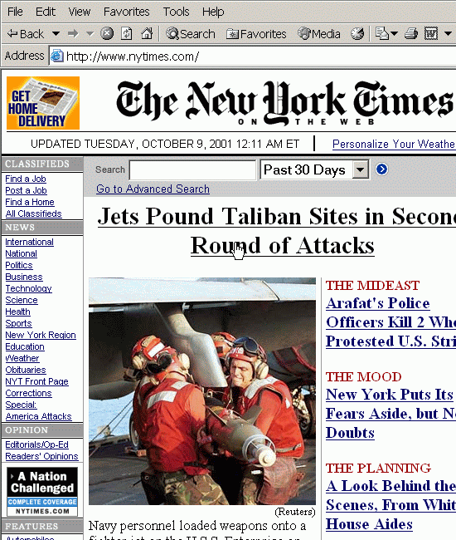
Topic: Search Engine (Central Indexing)
Central Index

Slide 9
Topic: Search Engine (Central Indexing)
Web: collection of static HTML pages
Find Web pages relevant to a query
Traditional Information Retrieval:
Web = collection of HTML pages
HTML page = a bag of words
More than that?
Links, structure of the Web
User access patterns
HTML tags (markups)

Slide 10
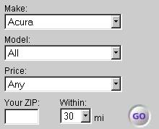
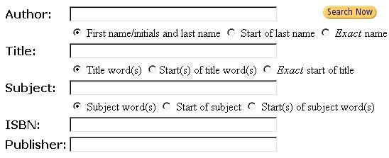
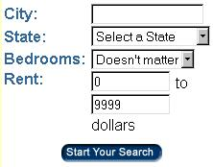
Topic: Dynamic Integration
Cars.com
Amazon.com
Truecar.com
Apartments.com

Slide 11
Topic: Dynamic Integration
Mediator
Wrapper
Wrapper
Wrapper
Source 1
Source 2
Source n
Notes:
The second approach that I mentioned is dynamic integration.
In this approach, instead of considering the Web as a collection of static and passive pages, we consider the Web as a collection of active and intelligent services.
For example, if we think about the Amazon Web site, it is not just a set of static Web pages. It provides some search functionality over its contents, so that the users can submit some queries and the site returns a list of relevant results. So in this approach, the main idea is that instead of considering them as passive pages, we will exploit these rich functionalities that the individual sources provide.
So there is a central program, called mediator, with which the users interact, and based on the user’s submitted queries the mediator figures out which source to access in what order, and contact the right sources to get relevant results.
However, because the sources or Web sites always have some differences, there is a small layer, called wrappers, on top of each source, which translates the users’ queries to the native queries that individual sources understand.

Slide 12
Topic: Data Mining
Structured data
Beatles $10
Madonna $20
NSync $20
WWW
How can we extract “structured data” from unstructured/free text automatically?

Slide 13
Focus of CS246
Central Indexing a.k.a. “Search Engine”
Information Retrieval (IR) System
Systems backed by 50-year research
Challenge: How can we support intuitive “natural-language based” search on Web documents?
How can machines “discover” Web pages?
How can machines “understand” text and query?
How can machines identify “relevant” document?
How can machines return documents quickly?
Possibly other approaches as well depending on student interest…

Slide 14
Prerequisite
Introductory database, e.g., CS143
e.g.: query? SQL?
Basic algorithms and data structures
Basic probability and statistics
P(A|C), Bayes rule, …
Programming experience
Project is done using basic Java

Slide 15
Course Workload
Lectures: 4 hours per week
Paper reading assignments
Submit short summary for each paper
About one paper per week
Project
Split into four parts
Use ElasticSearch, Mallet, and Java to index and analyze Wikipedia documents
Students must know (or is willing to learn) basic Java and Unix
One exam (final)

Slide 16
Course Objective
Learn theory (lectures)
Information retrieval (IR) models, data structures and algorithms
Search engine architecture and algorithms
Learn practical tools (projects)
Theory without practice is an “intellectual pastime”
Learn how to “implement” learned theory using real tools
Learn how to read paper (paper reading assignments)
Reading papers is what you do as a software engineer or research scientist
Reading papers is hard! Papers are written with different objectives than textbooks
It takes time and practice to learn reading papers

Slide 17
Paper Reading
Why:
Something that you will do all the time as a software engineer or researcher
Learn to be critical and communicate well
Acquire knowledge to conduct research and/or project
What:
“Classic papers” in information retrieval, search engines, etc
Roughly one paper per week
How:
Read papers and write a short summary
All papers are available on our class Web site
http://oak.cs.ucla.edu/classes/cs246/papers.html
Username: cs246, password: papers

Slide 18
How to Read Papers
Key: Understand the “big picture” first
Details are often VERY DIFFICULT to get
Try to understand the high-level idea first and go into the details only if needed
Understanding “big picture”
What is the problem?
Why is it important?
Why is it difficult?
What has this paper done?
What others have done?

Slide 19
Paper Summary
Summary is required so that everyone reads assigned papers
Without this, no one will read them…
Required components: at most 3 paragraph
Summary (1 paragraph): your own words
This paper discusses how to optimize queries with...
Comments/criticisms (1-2 paragraphs): the good & the bad
It addresses a real problem and the solution is interesting …
But I feel the experiments are not realistic because...
Optional: questions, as many as you want
Why the authors assume that queries are independent?
Summaries are graded as “Excellent”, “Great”, or “Poor”
Most reviews will get “Great” unless it is written extremely poorly/well (say, less than 10% will get either “Excellent” or “Poor”)

Slide 20
Class Project
Why:
Learn how to apply learned theory to real system and dataset using practical tools
How:
Must be completed individually
Must be done inside a “virtual machine” provided by us
Ubuntu 16.04, Java JDK 8, Gradle 4.1, ElasticSearch 5.6.2, Mallet 2.0.8
No installation, set up, and configuration problems
Students must feel comfortable using Unix/Linux commands and programming in Java
What:
Index Wikipedia dataset using ElasticSearch
Customize ranking function of ElasticSearch
Implement a simple spell checker
Perform SVD and topic analysis on real dataset

Slide 21
Exam
Final: December 11, Friday 4-6 PM (10th week)
If you are in a different time zone (not in the Pacific Standard Time), please submit your time zone info via the following link
https://forms.gle/LgeRTAwyhnqAwzNT8

Slide 22
Grading
Paper reviews: 10%
Project: 50%
Final: 40%

Slide 23
Textbook
No required textbook
Optional reference
Introduction to Information Retrieval by Christopher D. Manning, Prabhakar Raghavan and Hinrich Schütze
It is useful if you need to read more details on a certain topic.

Slide 24
Communication
All lectures are conducted via Zoom and will be recorded and be made available
Monday, Wednesday: 10:00AM – 11:50AM
https://ucla.zoom.us/j/96835293526
Meeting ID: 968 3529 3526, Passcode: 154806
Office hours are conducted through separate zoom links
Instructor: Tue 2:30-3:30PM https://ucla.zoom.us/j/93519403269

Slide 25
Course Information
Other course materials are available on our Web site
http://oak.cs.ucla.edu/classes/cs246
Piazza will be used for
Online discussion and general question
Personal communication between a student and course staff
Please send a “private message” on Piazza for personal communications
https://piazza.com/class/kfmtpazr6o14ll
Gradescope will be used for assignment submissions
Paper summary
Project deliverable
https://www.gradescope.com/courses/193352

Slide 26
Announcements
First paper summary is due this Sunday
“The Anatomy of a Large-Scale Hypertextual Web Search Engine” by Sergey Brin and Lawrence Page (yes, they are them!)
First project will be released this Sunday
Project overview is already online
Please take a look at our class Web site
Please sign up for Piazza and Gradescope if you have not
Piazza signup link available on the course Web site
Please submit your time zone information if you are not local
https://forms.gle/LgeRTAwyhnqAwzNT8

